Slide 1



Slide 2

Our Website Logo

Slide 3
z
Team Members
Bibhas Shrestha (Team Leader)
Abhash Niroula
Srijan Thapa
Manoj Chhetri

Slide 4
z
OBJECTIVES
Maintain or increase the shop turnover
within 12 months of launching the website.
Attract new customers that would otherwise
not be able to shop with the traders.
Be usable by traders within a normal and
suitable working time.
Create a responsive interface so that it can
be accessed across multiple devices.

Slide 5
z
Five Phases of Project Management
Project Planning
Project Management
Project Design
Project Development
Project Closing

Slide 6

z
Project Planning
INCLUDES
Project Charter V1
Project Charter V2
Belbin Analysis
Skill Audit

Slide 7
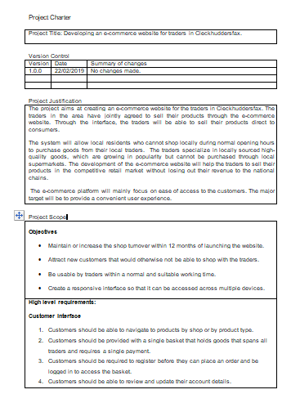
z
Project Charter V1
Comprised of ?
Version control
Justification
Project Scope

Slide 8
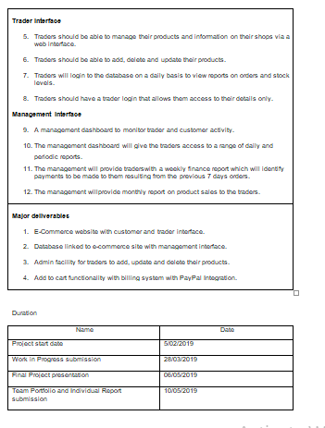
z
Project Charter V1
Project Scope
Includes
Objectives
Requirements
Major
Deliverables

Slide 9
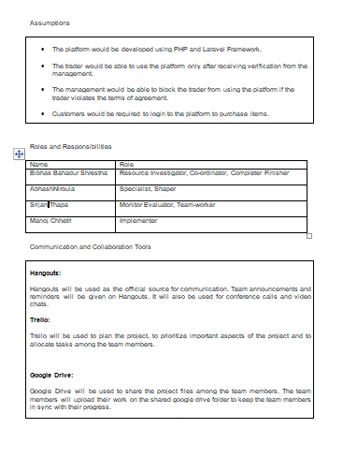
z
Project Charter V1
Comprised of ?
Duration
Assumption
Roles and
Responsibilities
Communication
Tools

Slide 10


z
Project Charter V1
We will be focusing on
Roles and Responsibility
Communication Tools

Slide 11
z
Roles and Responsibility
Names
Roles
Bibhas Shrestha Resource Investigator,
Coordinator,
Complete Finisher
Abhash Niroula Specialist, Shaper
Srijan Thapa Monitor Evaluator,
Team Worker
Manoj Chhetri Implementer

Slide 12



z
Communication Tools

Slide 13
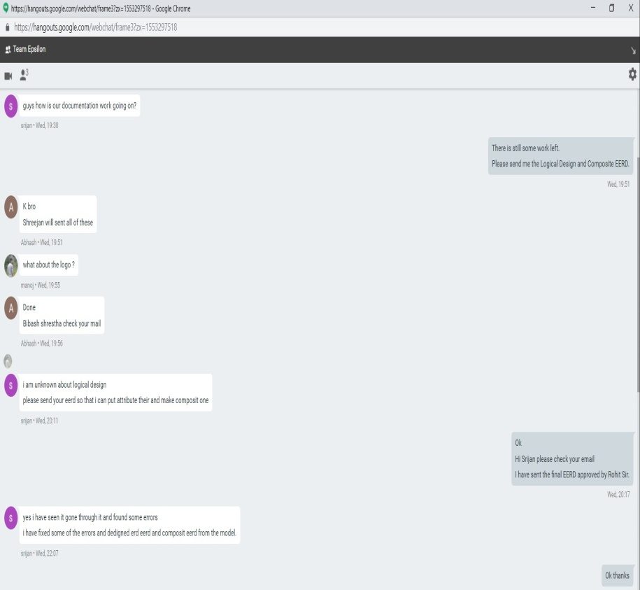
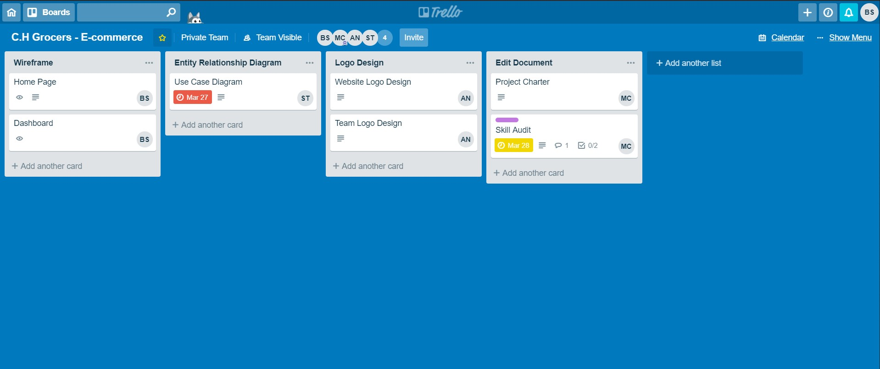
z
Screenshots of Communication

Slide 14
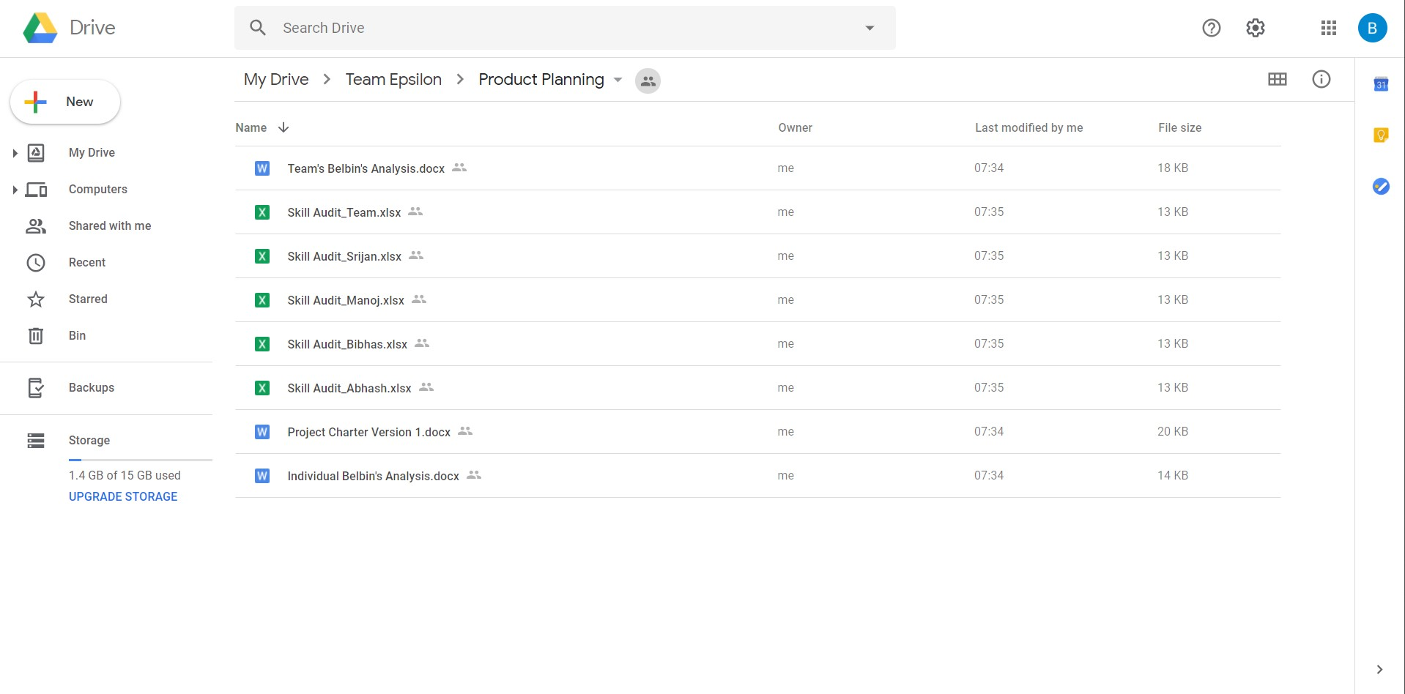
z
Screenshots of Communication

Slide 15
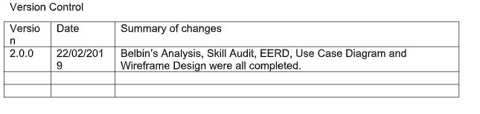
z
Project Charter V2
Key changes Made?
Belbin Analysis
Skill Audit
EERD
Use Case Diagram
Wireframe

Slide 16
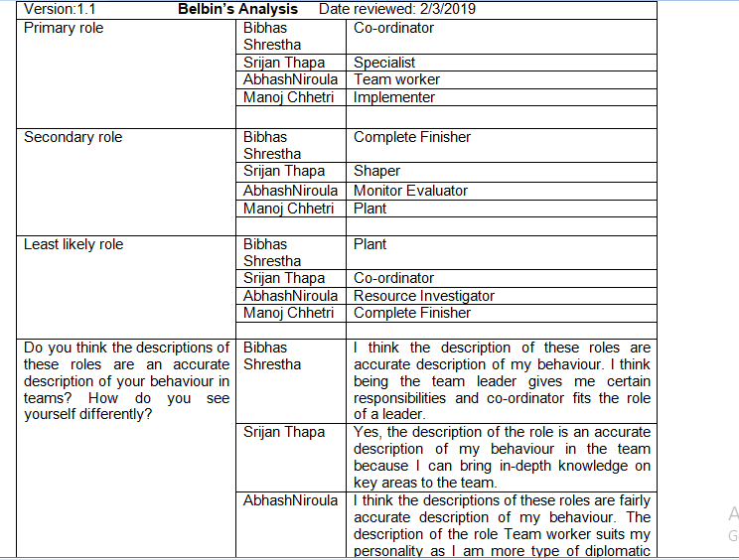
z
Project Planning
Belbin Analysis

Slide 17
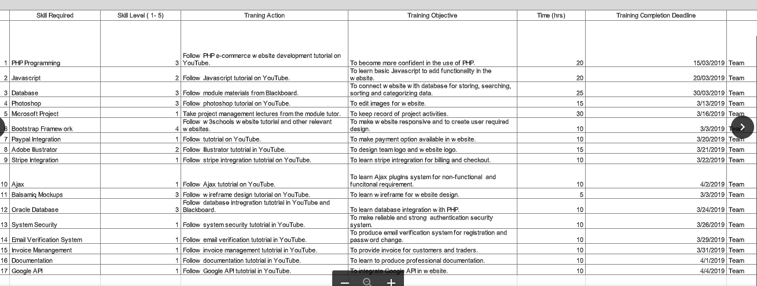
z
Project Planning
Team Skill Audit

Slide 18

z
Project Management
Includes
MS Project

Slide 19
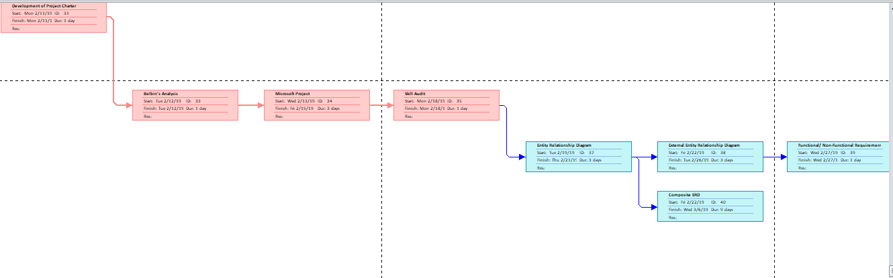
z
Project Management
MS Project for keeping track of progress
Network Diagram

Slide 20
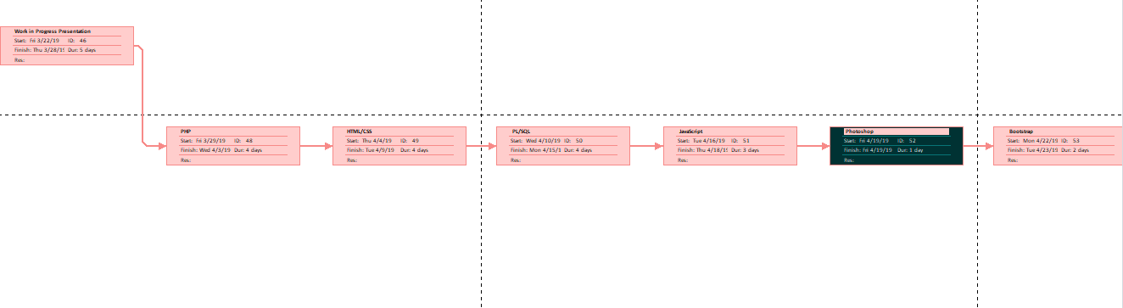
z
Project Management
MS Project for keeping track of progress
Network Diagram

Slide 21
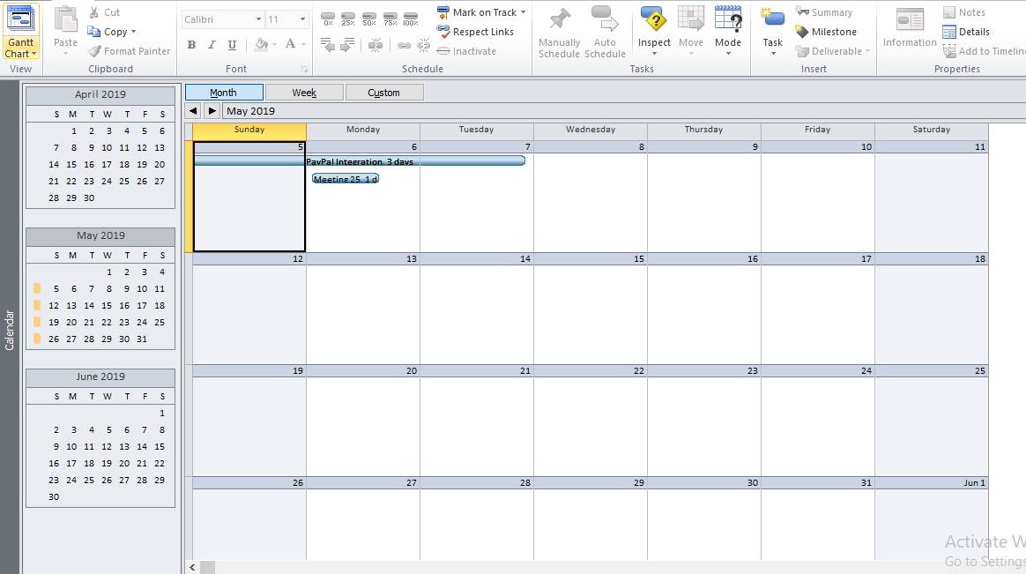
z
Project Management
Calendar

Slide 22
z
Project Design
Includes
ERD
EERD
Composite ERD
Use case Diagram
MOSCOW Rules
Wireframe

Slide 23
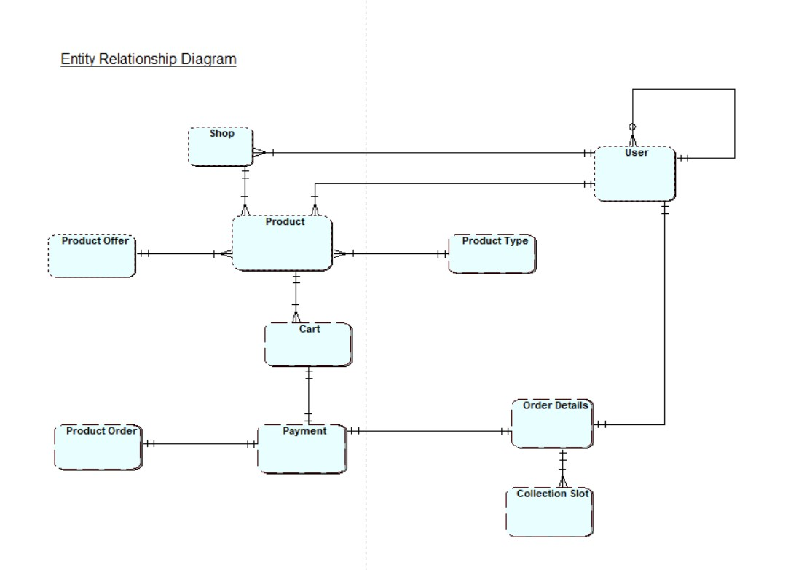
z
Project Design
ERD

Slide 24
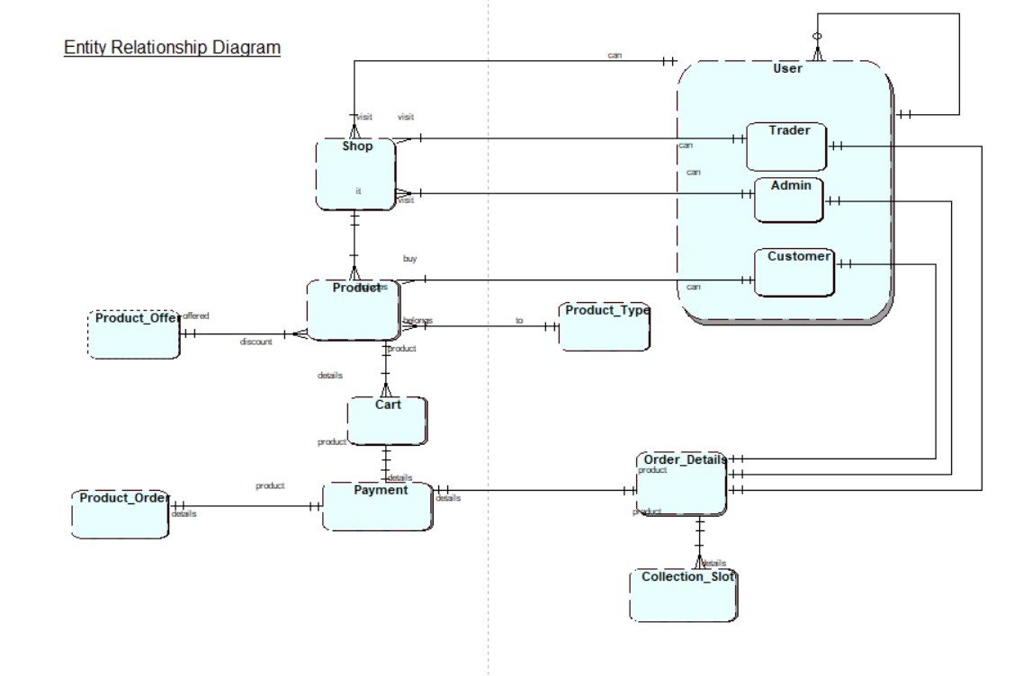
z
Project Design
EERD

Slide 25
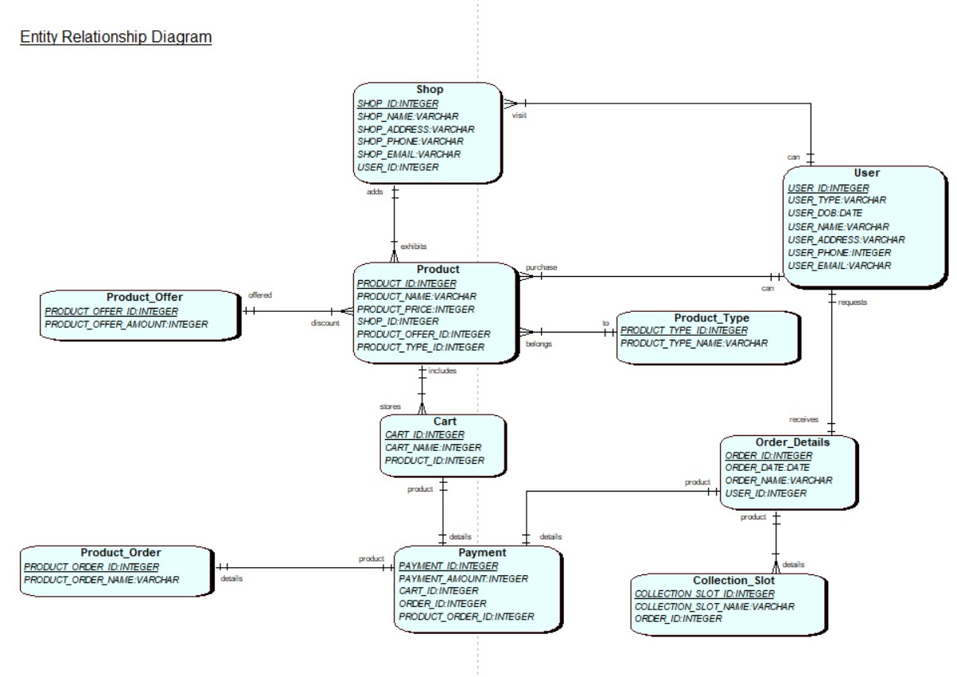
z
Project Design
Composite EERD

Slide 26
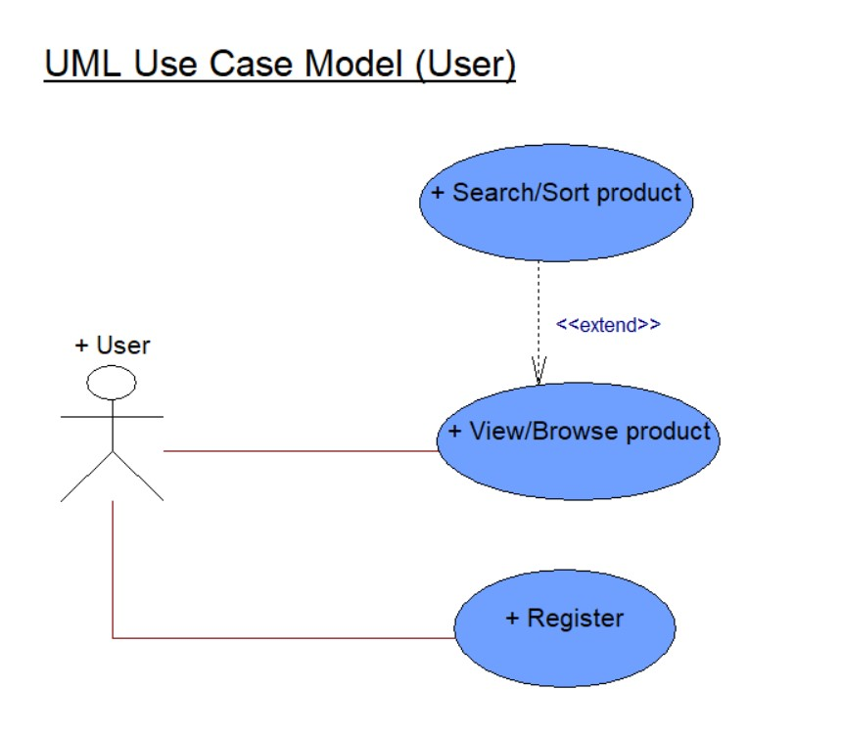
z
Project Design
Use case Diagram

Slide 27
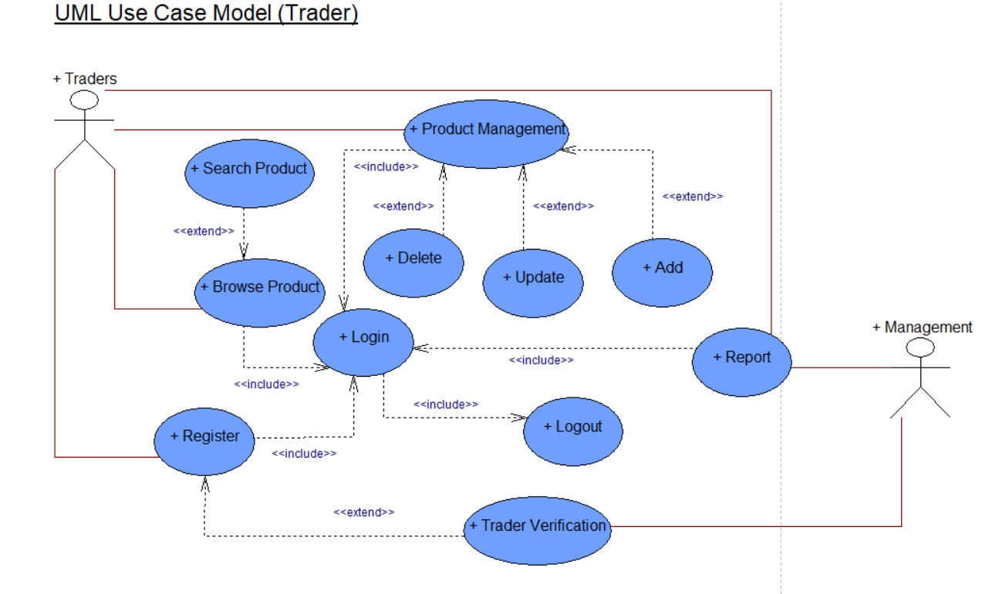
z
Project Design
Use case Diagram

Slide 28
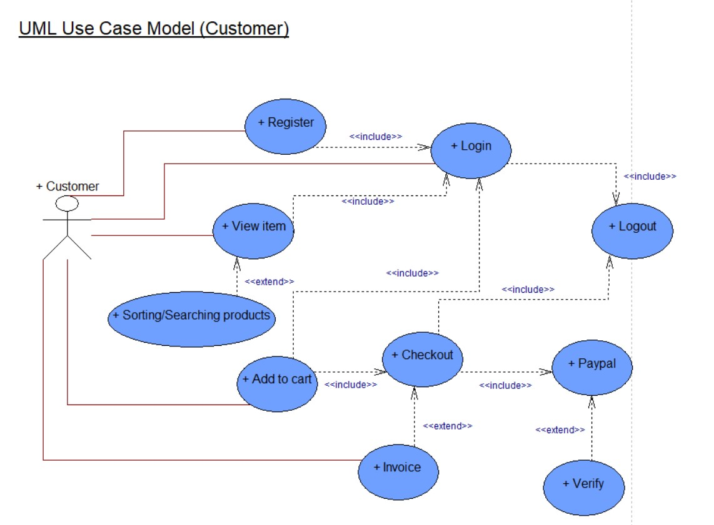
z
Project Design
Use case Diagram

Slide 29
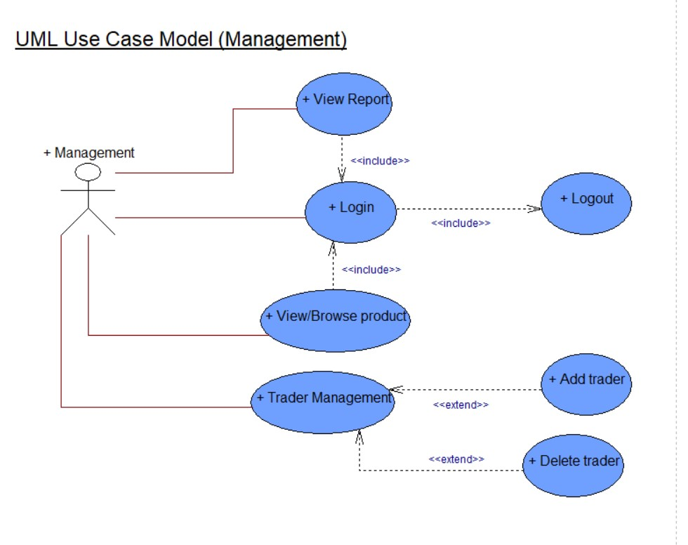
z
Project Design
Use case Diagram

Slide 30
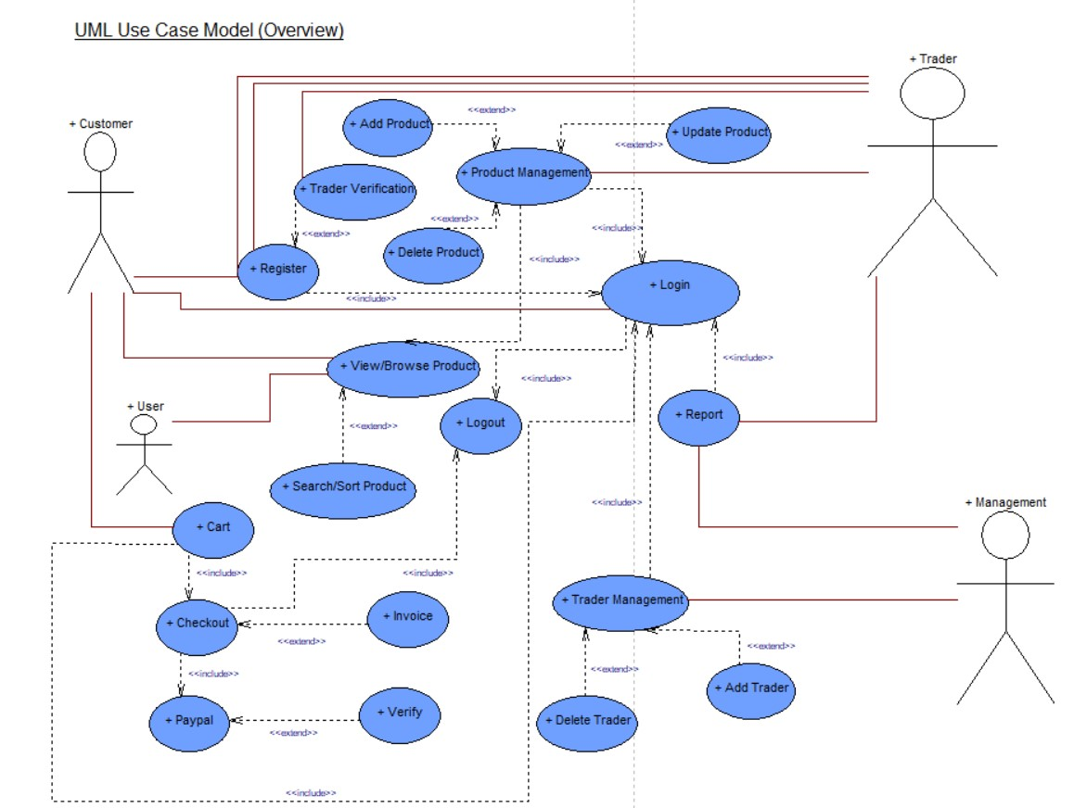
z
Project Design
Use case Diagram

Slide 31
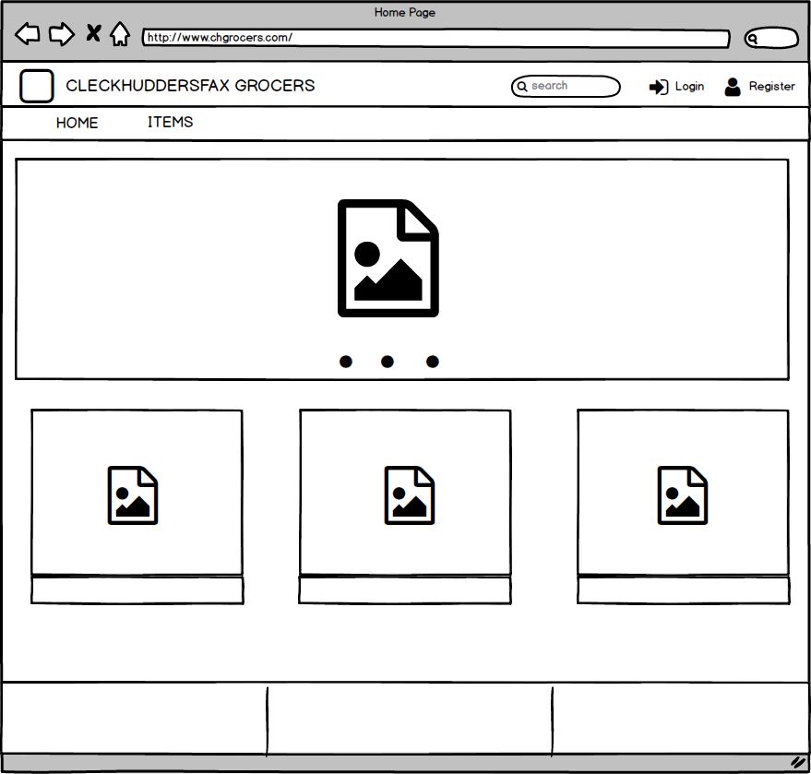
z
Project Design
Wire Frame
Homepage

Slide 32
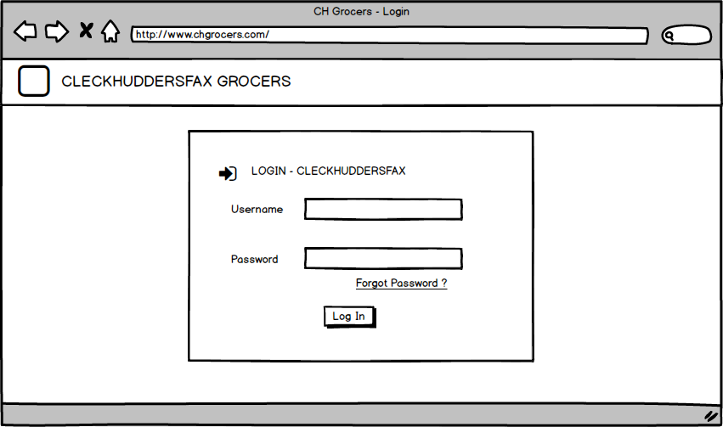
z
Project Design
Wire Frame
Login Page

Slide 33
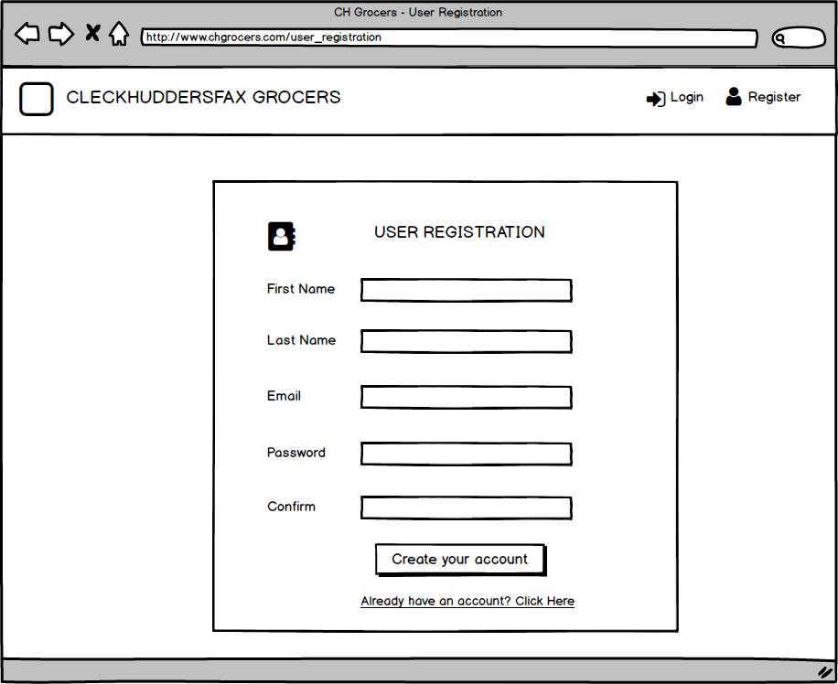
z
Project Design
Wire Frame
User Registration

Slide 34
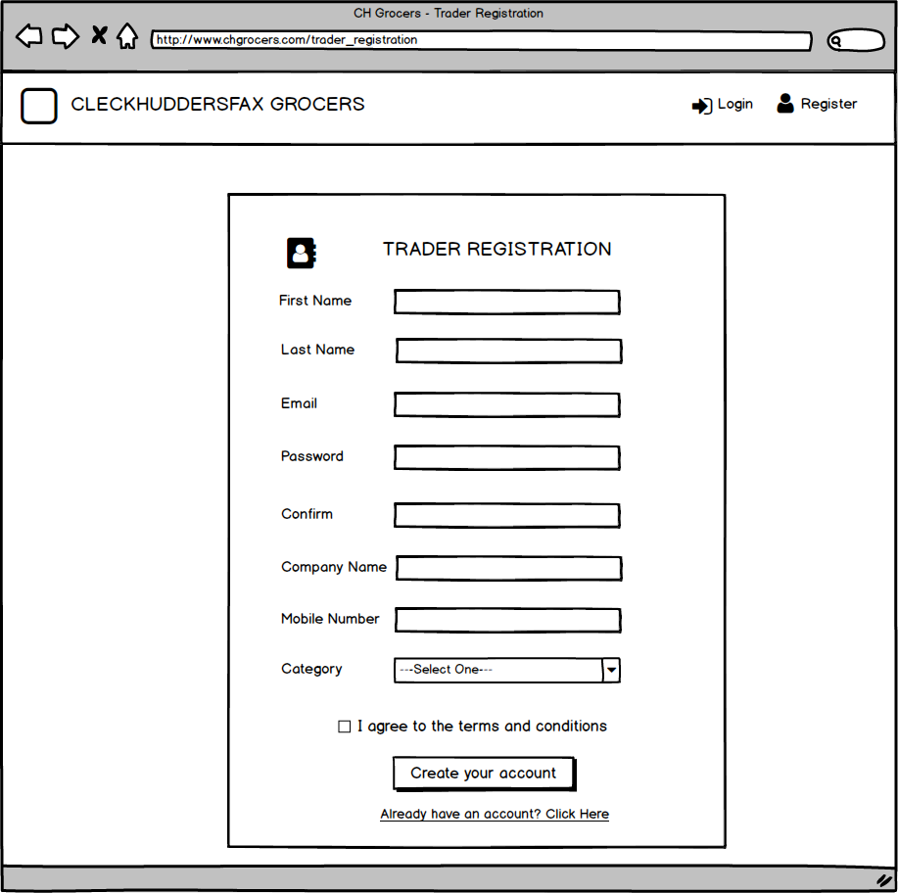
z
Project Design
Wire Frame
Trader Registration

Slide 35
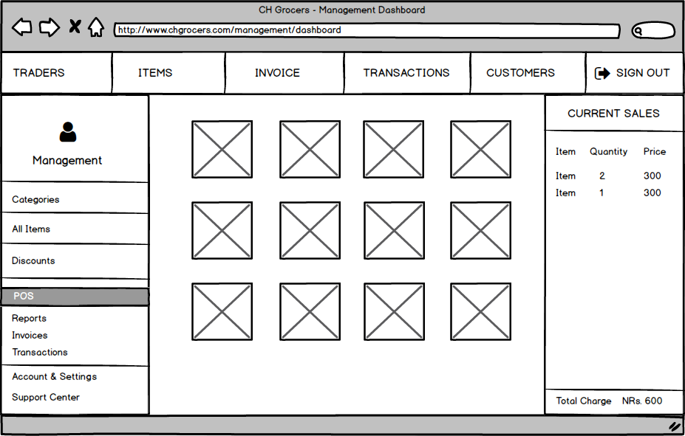
z
Project Design
Wire Frame
Management
Dashboard

Slide 36
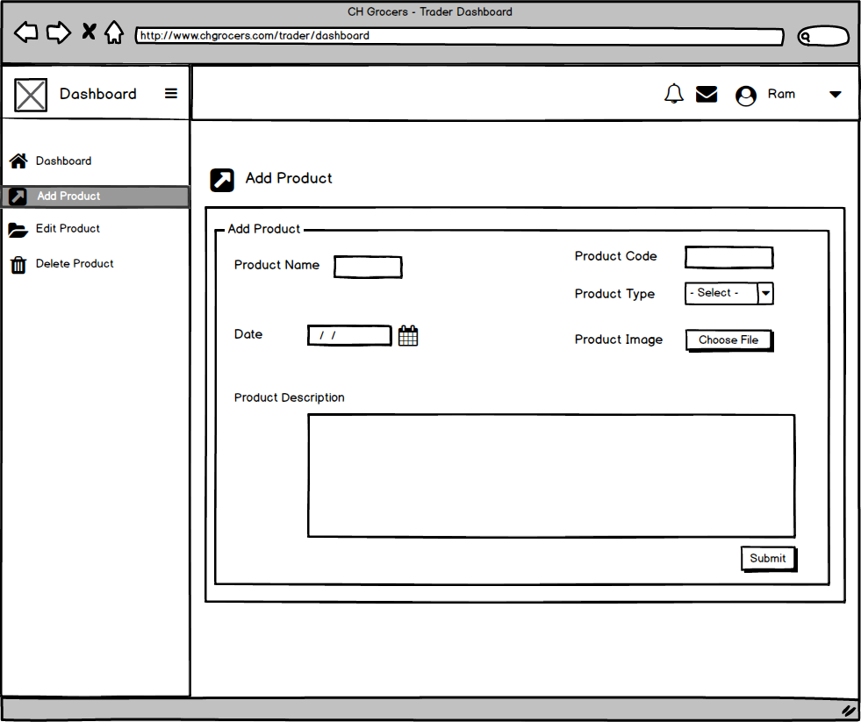
z
Project Design
Wire Frame
Trader
Dashboard

Slide 37
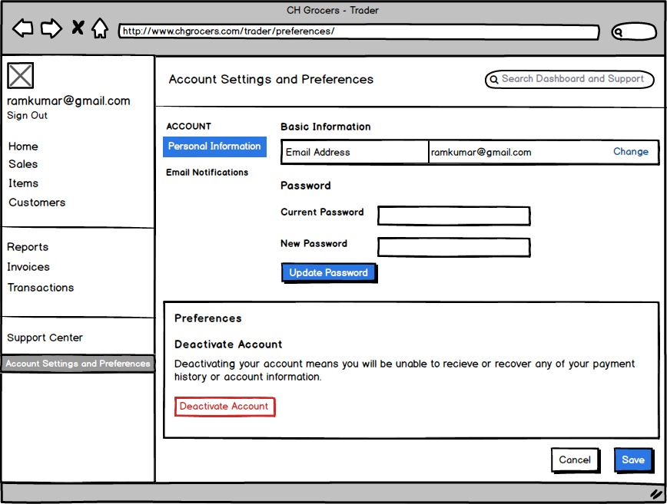
z
Project Design
Wire Frame
Account
Settings

Slide 38
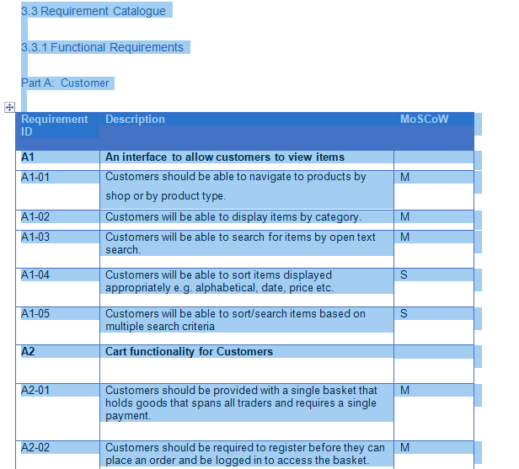
z
Project Design
MOSCOW

Slide 39
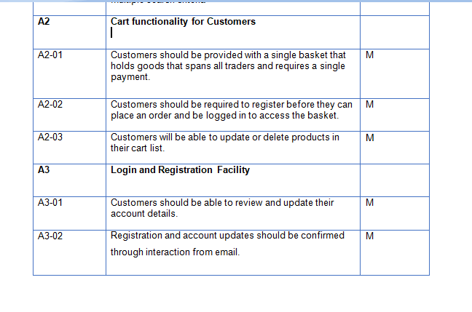
z
Project Design
MOSCOW

Slide 40
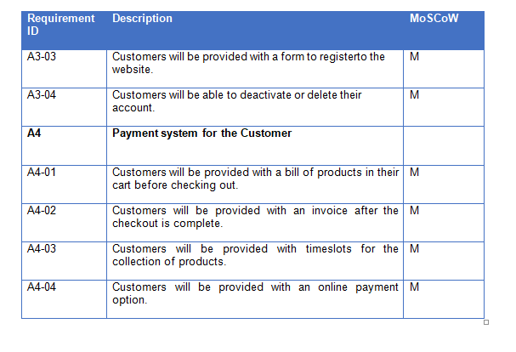
z
Project Design
MOSCOW

Slide 41
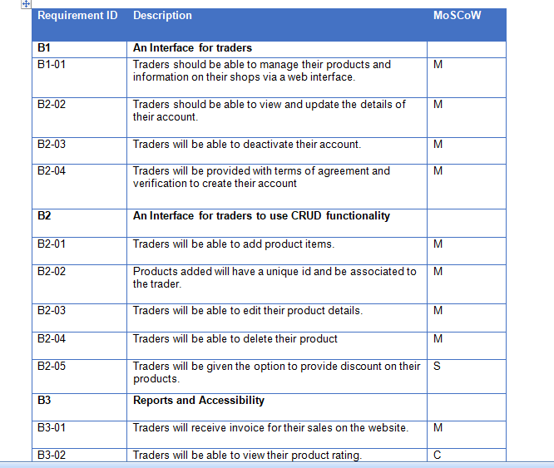
z
Project Design
MOSCOW

Slide 42
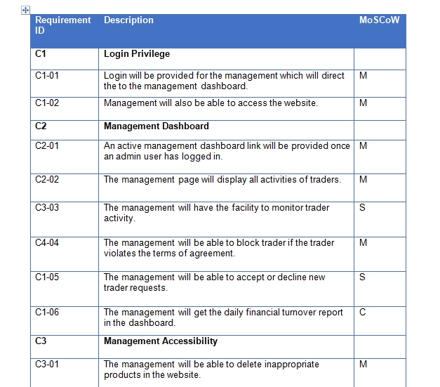
z
Project Design
MOSCOW

Slide 43
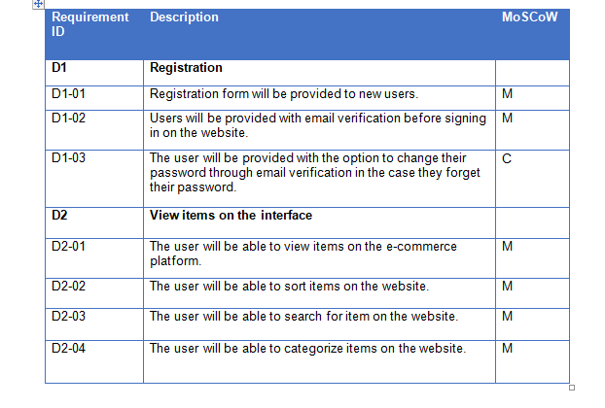
z
Project Design
MOSCOW

Slide 44
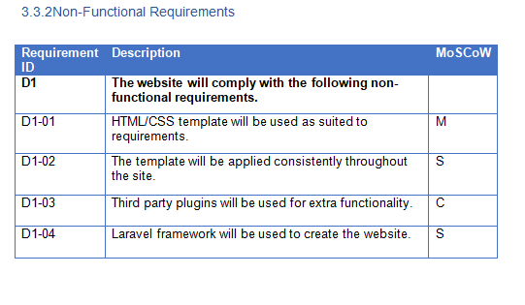
z
Project Design
MOSCOW

Slide 45
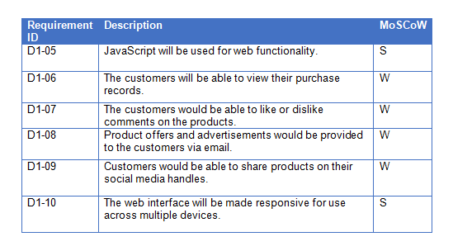
z
Project Design
MOSCOW

Slide 46
z
Project Development
INCLUDES
Work in Progress
Oracle Table
Homepage

Slide 47
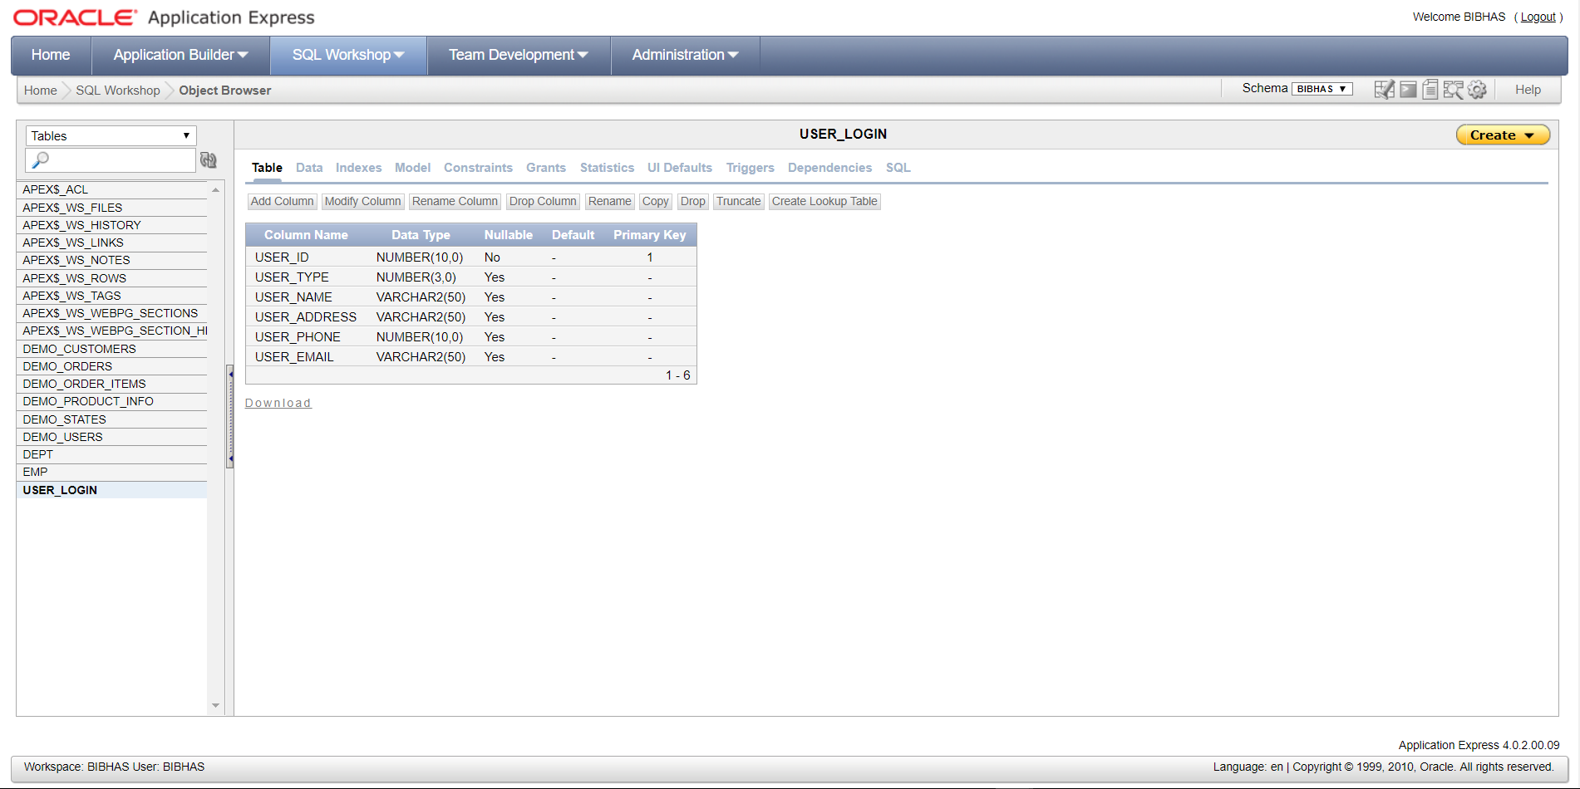
z
Project Development
User Table

Slide 48
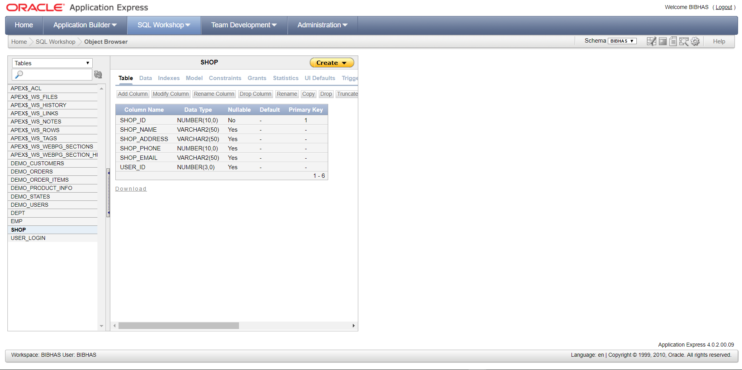
z
Project Development
Shop Table

Slide 49
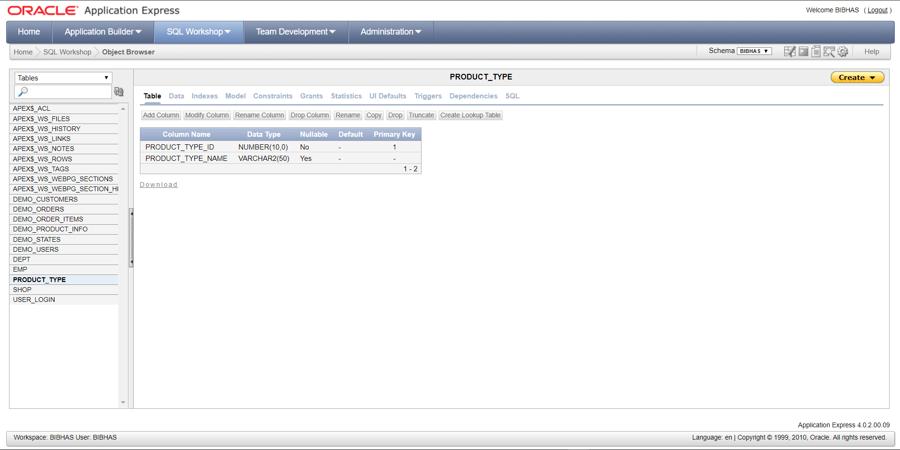
z
Project Development
Product
Type Table

Slide 50
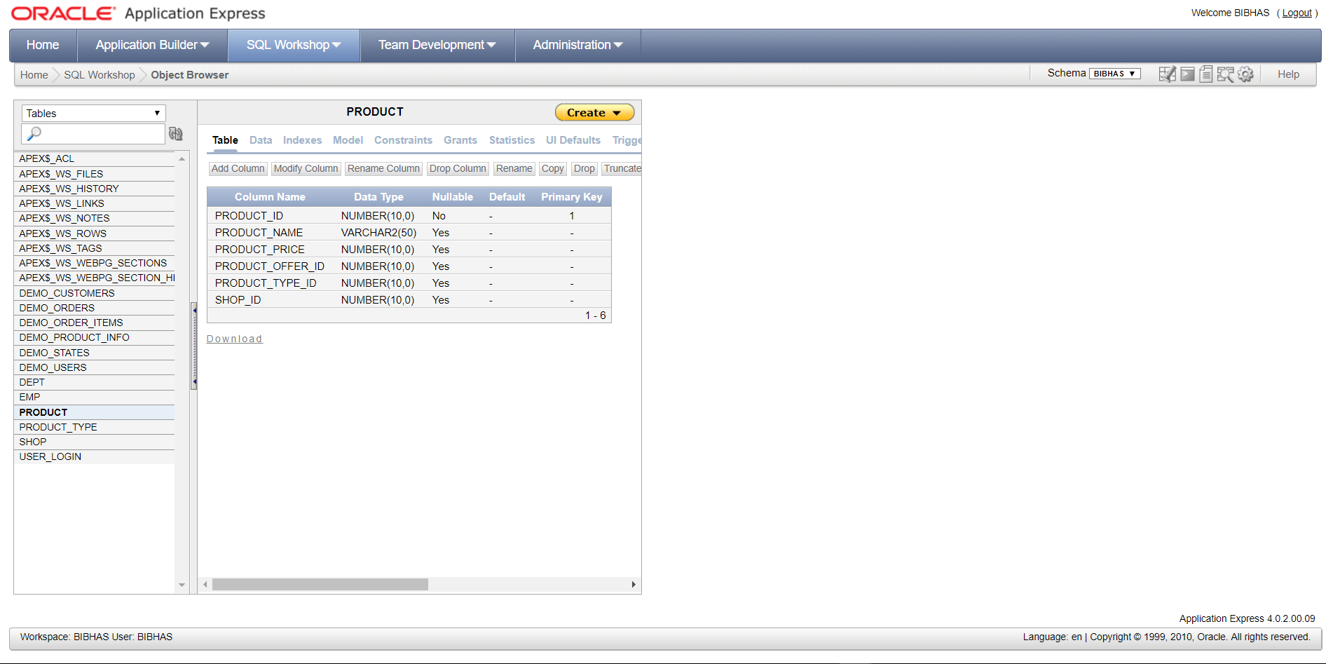
z
Project Development
Product Table

Slide 51
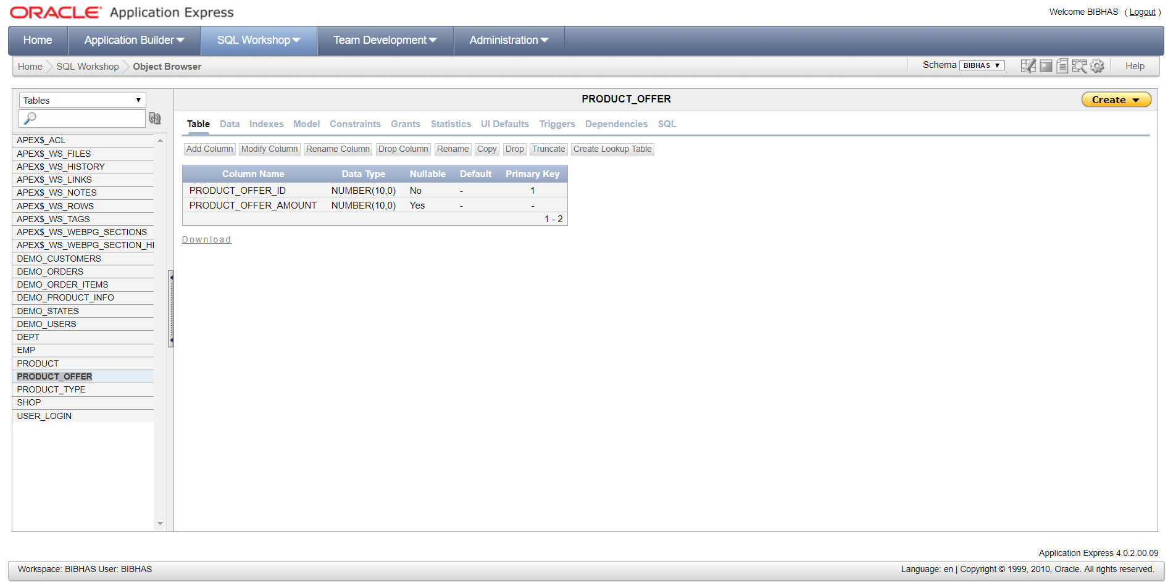
z
Project Development
Product
Offer Table

Slide 52
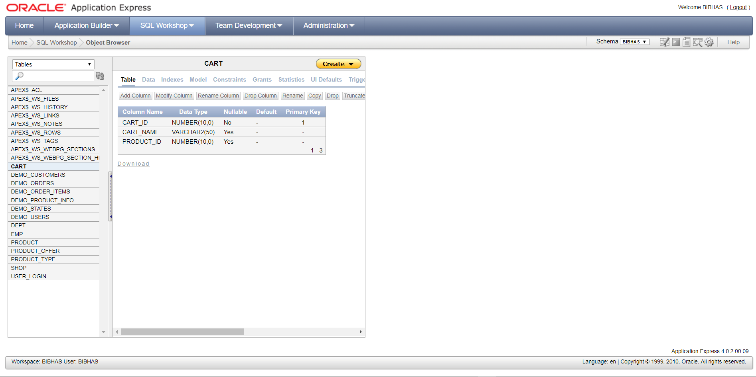
z
Project Development
Cart Table

Slide 53
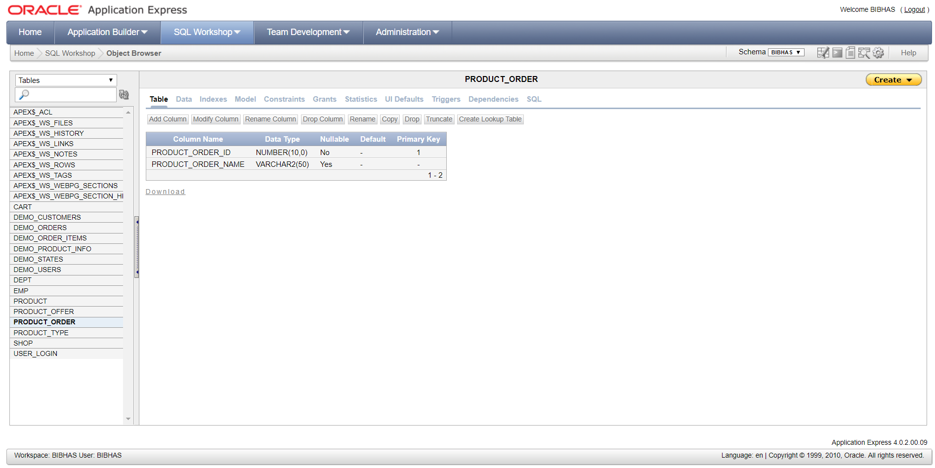
z
Project Development
Product
Order Table

Slide 54
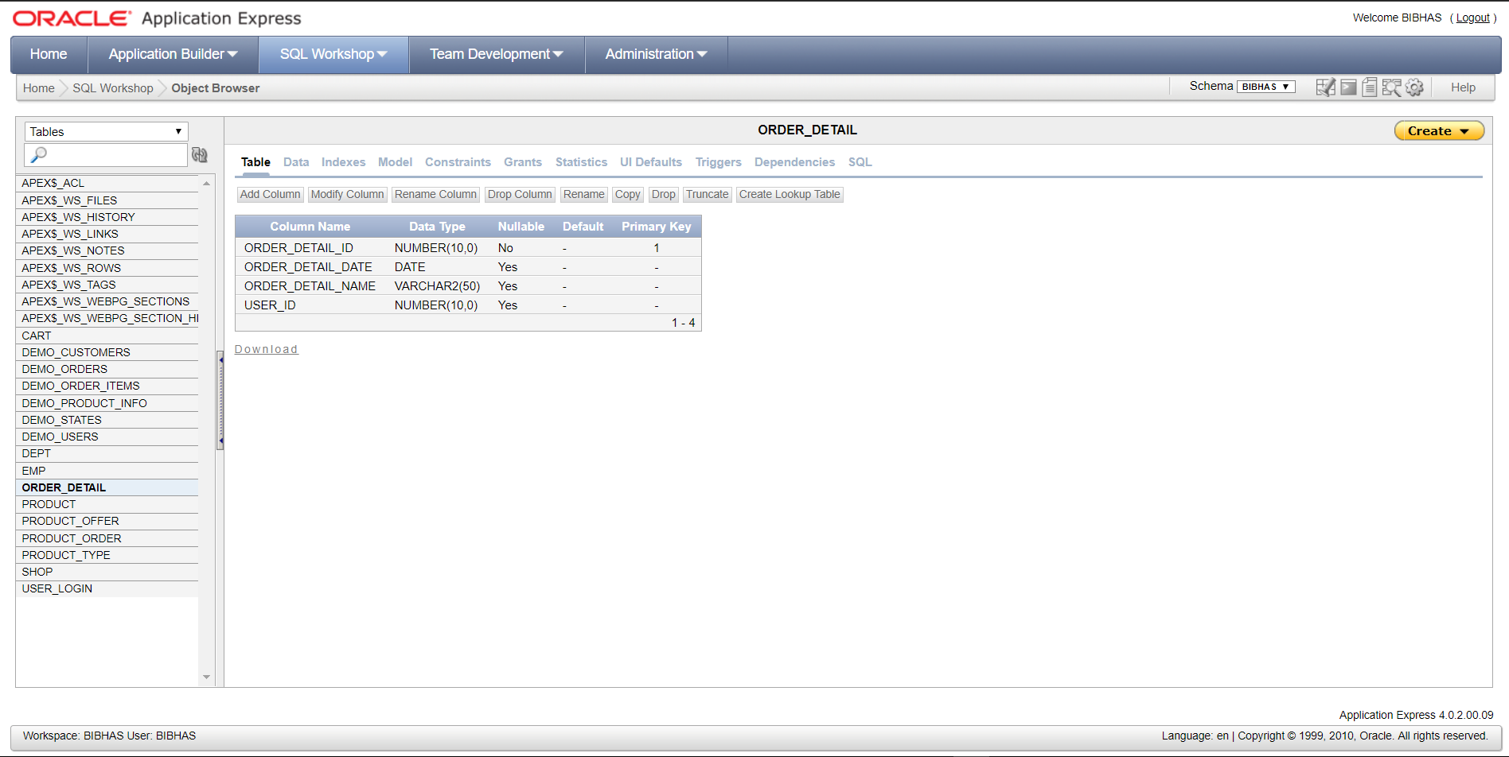
z
Project Development
Order Detail
Table

Slide 55
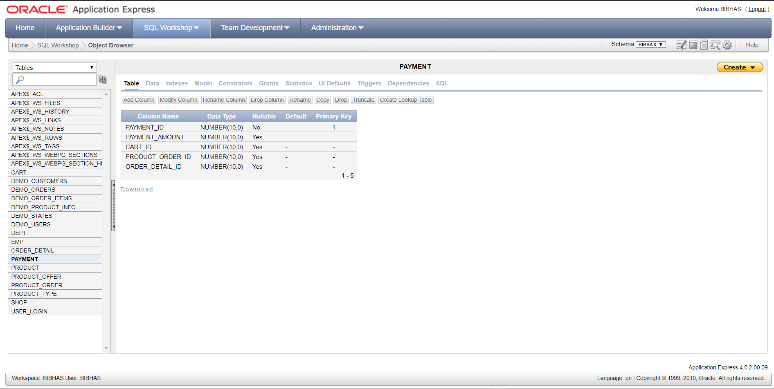
z
Project Development
Payment Table

Slide 56
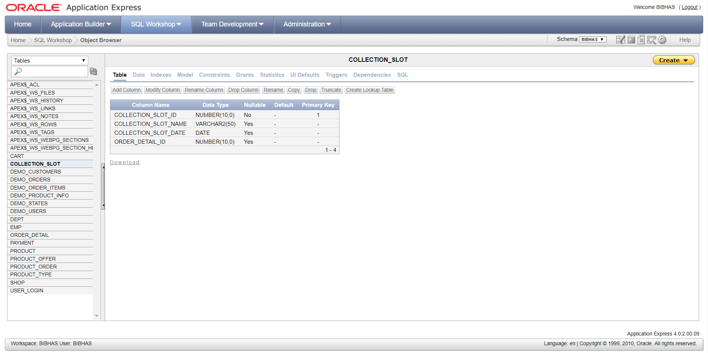
z
Project Development
Collection Slot
Table

Slide 57

z
Project Development
Work in
Progress
Homepage

Slide 58
z
THE END

